Slide 1





MAMACARE AI
Supporting the pregancy to after-birth journey
care with AI
July 2026
Kasalite

Slide 2




A FRAGMENTED JOURNEY
Maternal deaths don’t happen at a single moment. They are the result of missed signals across the entire journey.
800+
Maternal deaths don’t happen at a single moment. They are the result of missed signals across the entire journey.
women die every day from preventable
causes related to pregnancy and childbirth.
1 in 3 women in rural Sub-Saharan Africa has mobile internet.
have acess to basic phone (GSM Voice with SMS)
*WHO Maternal mortality fact sheet 2025
*GSMA Mobile Internet Connectivity 2023
*GSMA Mobile Gender Gap 2023

Slide 3
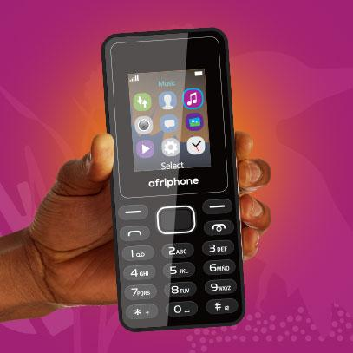

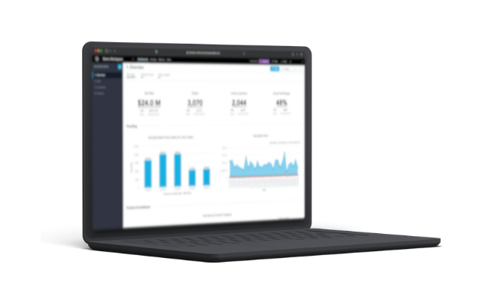
SOLUTION
Voice Conversational AI Agent for prenatal risk prediction to postpartum recovery
FOR THE MOTHER (Zero-Friction Innovation)
FOR THE HOSPITAL (Core SaaS Component)
No app. No data. 24/7 access.
Real-Time Risk Flagging
Prenatal: Proactive scheduled/outbound calls to track risks between ANC clinic visits.
User Management & Activity Log
Postpartum: 24/7 inbound/outbound voice guidance for infant care questions, mental health etc.
Support multiple languages

Slide 4


$100M
Addressable facility-births with phones across sub-saharan regions.
MARKET OPPORTUNITY
TAM
$3.5M
SAM
800,000+ facility-delivered mothers annually with phone access.
$500,000+
Capturing the top 150 high-volume private & government hospitals
SOM
Hospitals
Telcos
Government
Insurance
NGOs
MAJOR STAKEHOLDERS

Slide 5
COMPETITIVE LANDSCAPE
MAMACARE AI DIFFERENTIATION
ALTERNATIVE
FLAWS
Smartphone Apps (e.g., Ovia, BabyCenter)
Require smartphones, mobile data, and digital literacy.
Works on any FEATURE phone. No app, no data required.
Expensive to scale, impossible to monitor mothers at 2AM or Daily
Provides continuous monitoring
Community Health Workers
We are building the invisible infrastructure that connects basic-phone patients to hospital clinical workflows.

Slide 6

REVENUE MODEL
MINIMUM DIRECT COSTS TO THE MOTHER
Hospitals
Telcos
*$5-7$/
Value Added Services (VAS) Lincensing
per mother enrolled (12-week period)
Private Insurers
Premium maternity add-on
bundle fee

Slide 7











IMPACT
Reduced Maternal Mortality
MM reduced with timely and continuous care. Voice Agent check-ins catches danger signs between visits before they're fatal.
SDG Alignment
Increased Maternal Health Service Productivity
Our system enables the health institutions manage large number of prenatal mothers at an increased efficiency
Bridges Infrastructure Barrier
Over 90% GSM reachable. Continous Maternal Care accessible to anyone irrespective of geographical locataion and respource

Slide 8
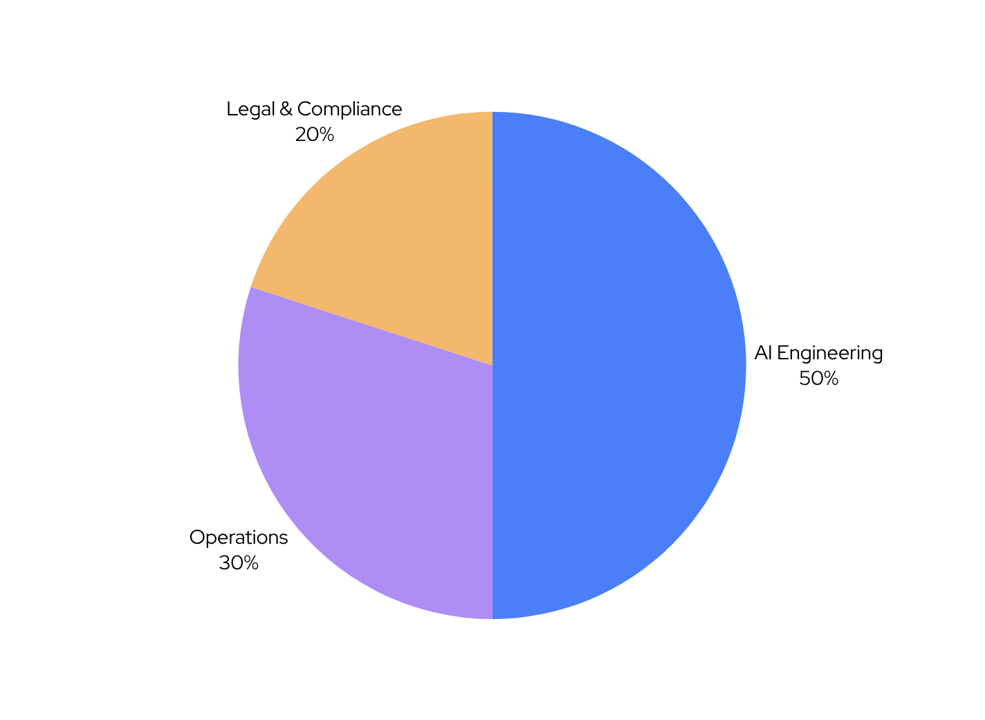
Use of Funds
THE ASK
Integrating Voice APIs, building the hospital dashboard, and AI Agent Orchestration
HIPAA compliance
$50,000 Seed Round
Mentorship
Value Inflection Point
  Month 9 - converting our pilot into our first paying B2B hospital contract
Funding Telco costs for pilot inbound calls

Slide 9




OUR TEAM
ROSEMOND OSEI
SAMUEL DANQUAH ANKAPONG
AMETEPI GRACE ABLA
TEAM LEAD
PRODUCT LEAD
HEALTH TECH INNOVATOR
Biomedical Engineer & Public Health Expert with 3+ years of experience
Full stack AI/ML Engineer with 4+ years of experience
2+ years of experience

Slide 10

LETS SUPPORT
ABENA AND OTHER MOTHERS
“Supporting mothers every step of the way”

